Slide 1
HIRING TRENDS IN FIN-TECH COMPANIES
Team 5 –
Nikita Gawde
Bhavya Haridas
Harshitha S Gaddadhar
Saumil Shah

Slide 2
ORGANIZATIONS ANALYSED
Charles Schwab Bank
PNC Financial Services Inc.

Slide 3
KEY INFERENCES
Proportion of the categories in which the companies hire.
Number of jobs offered in a one location.
Popular keywords used by companies while advertising their posting.

Slide 4
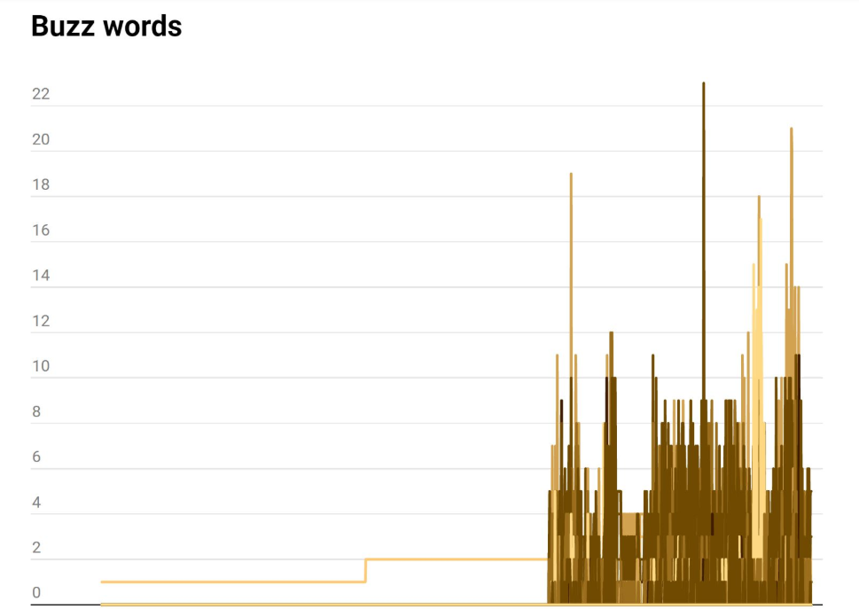

Slide 5
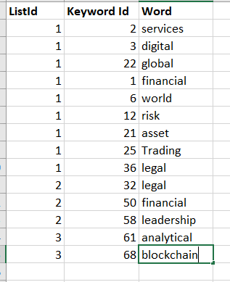

Slide 6
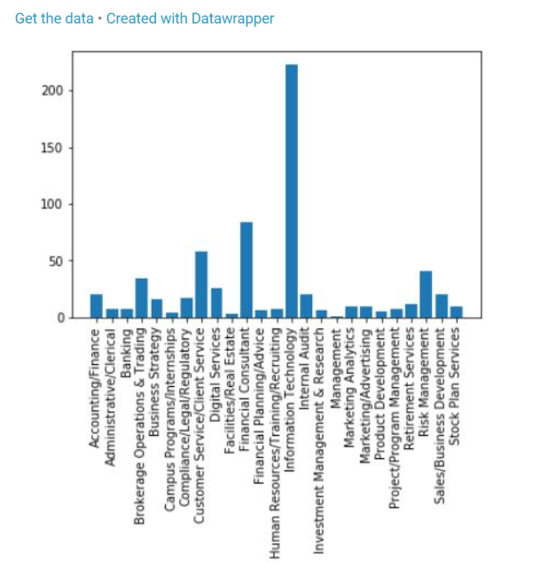
JOB CATEGORIES

Slide 7
